Slide 1
Tableau - introduction
Trish Conner-Cato

Slide 2
Module 1: creating your first visualizations and dashboard
Lesson 1
Connecting to data in Access
Lesson 2
Foundations for building visualizations
Lesson 3
Bringing everything together in a dashboard
Northwind

Slide 3

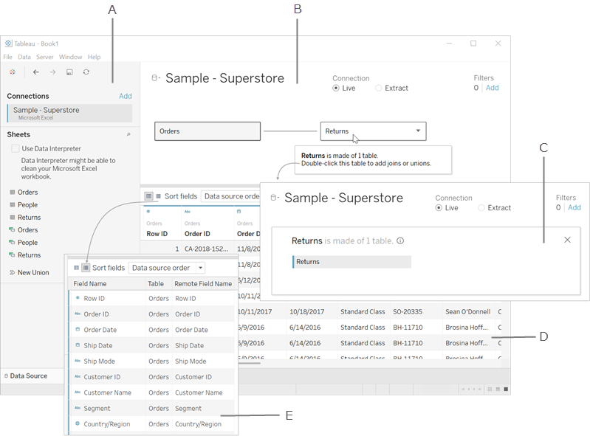
Module 1: tableau interface – data source view
Left pane – displays details about your data
Relationships canvas
Joins canvas
Data grid
Metadata grid

Slide 4
Module 1: logical and physical layers
Logical
This is the default view in the Data Source page canvas. This is the relationships (noodles) canvas.
Physical
You combine data between tables in this layer using joins and unions.
Each logical table contains at least one physical table.
You combine data in this layer using relationships.
This is the Join/Union canvas.

Slide 5
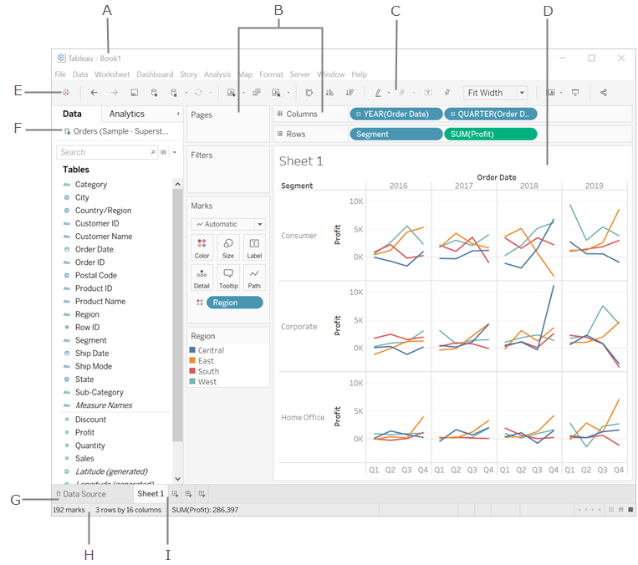
Module 1: tableau interface – sheet view
Workbook name
Cards & Shelves
Toolbar
View – the canvas where you create a visualization (“viz”).
Takes you to the start page
Side bar – contains the data pane and the analytics pane.
Data source tab – where you can view your data
Status bar – displays information about the current view and descriptions of menu items.
Sheet tabs – represent each sheet in your workbook. Can include a worksheet, dashboard, or story.

Slide 6
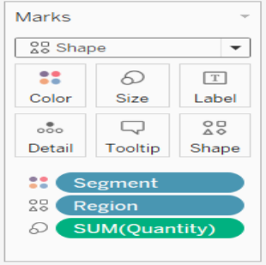
Module 1: the marks card
Tableau displays data using marks, where every mark corresponds to a row (or group of rows) in your data source.

Slide 7
Module 1: the marks card
SETTINGS | USE
Color | Updates all marks in the view to the color you choose. If you drag a discrete field (blue) to Color on the Marks card, the marks in the view will be broken out by that field , and each will be assigned a color. (e.g., Category). If you use a continuous field, each mark in the view is colored based on its value (e.g., Sales).
Size | Changes the size of marks in the view. If the field is a discrete field, the marks will be separated according to the members in the dimension, and assigns a unique size to each member. If the field is continuous, each mark is drawn with a different size using a continuous range.
Label/Text | Marks are separated according to the members in the dimension.
Detail | Marks are separated according to the members of that dimension. Dropping a dimension on Detail is a way to show more data without changing the viz structure.
Tooltip | Show when hovering over a mark. Can be edited to include both static and dynamic text. You can also modify which fields are included.
Shape | Changes the shape of marks.

Slide 8
Module 2: working with data in tableau
Lesson 1
The Tableau paradigm
Lesson 2
Connecting to data
Lesson 3
Working with extracts instead of live connections
Lesson 4
Metadata and sharing data source connections
Lesson 5
Joins and blends
Lesson 6
Filtering data
Tableau Sample Store data
Orders and Order Payments .csv files

Slide 9
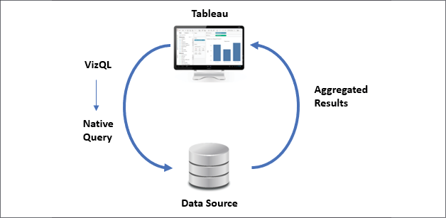
Module 2: the tableau paradigm
The Tableau paradigm, simply put, is the experience of working in Tableau as a result of VizQL (Visual Query Language). VizQL allows Tableau to translate your actions, as you drag and drop fields of data, into a query language that defines how the data encodes those visual elements.

Slide 10
Module 2: definitions
TERM | DEFINITION
Extracts | Static data – a snapshot of data based on criteria you select.
Live connection | Based on the most current data available
Metadata | Tableau facilitates in capturing the information details of the sources like columns and their data types. This is used to create the dimensions, measures, and calculated fields used in views. Metadata can be edited.
Relationships | Creates a relationship between tables based on a common field. Does not merge the data, but keeps it separate.
Joins | An approach to merge data from the same source, also based on a common field. Joins combine data and then will aggregate it.
Blends | An approach to combine data from multiple varieties of sources and display them on a single screen. Blending aggregates the data and then displays combined data.

Slide 11
Module 2: definitions
TERM | DEFINITION
Dimension | A dimension is a field that can be considered an independent variable. By default, Tableau treats any field containing qualitative, categorical information as a dimension (e.g., Region, State)
Measure | A measure is a field that is a dependent variable; that is, its value is a function of one or more dimensions. Tableau treats any field containing numeric (quantitative) information as a measure (e.g., Sales)

Slide 12
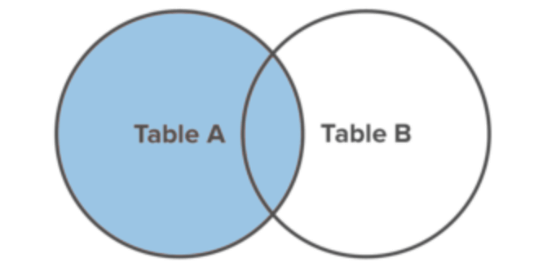
Module 2: join types – left join
Merges contents between two tables. The resulting table contains all the records from the left table and only matching records from the right table. If there are no matches in the right table, null values will be shown in the data grid.

Slide 13
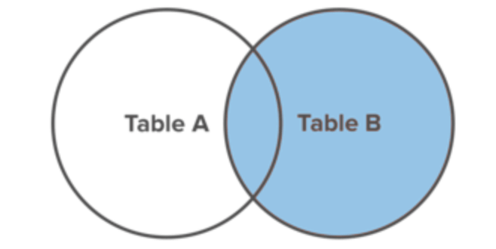
Module 2: join types – right join
Merges contents between two tables. The resulting table contains all records from the right table and only the matching values in the left table. If there are no matches in the left table, null values will be shown in the data grid.

Slide 14
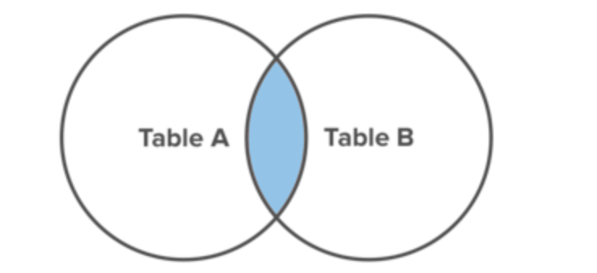
Module 2: join types – inner join
Only the common matching data between two tables is displayed.

Slide 15
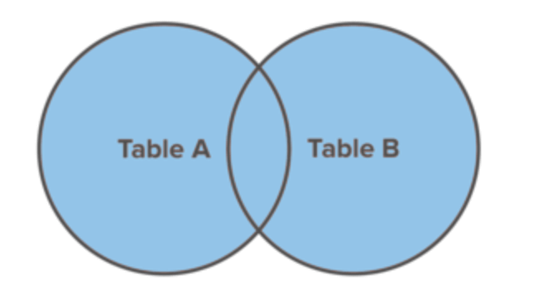
Module 2: join types – full outer join
Data from both tables are merged and displayed. The values that are not matching in both tables are shown as null values.

Slide 16
Module 3: moving from foundational to advanced visualizations
Lesson 1
Comparing values across different dimensions
Lesson 2
Visualizing dates and times
Lesson 3
Relating parts of the data to the whole
Lesson 4
Visualizing distributions
Lesson 5
Visualizing multiple axes to compare different measures

Slide 17
Module 3: definitions
TERM | DEFINITION
Qualitative | Qualitative data is descriptive.
Quantitative | Quantitative data is numbers-based, countable, or measurable.
Multiple Axes | Useful for analyzing measures with different scales.
Continuous | In terms of an axis, it is formed as an unbroken whole, without interruption. Generally, continuous fields add an axis to the view.
Discrete | In terms of an axis, it is individually separate and distinct. Generally, discrete fields add headers to the view.

Slide 18
Module 4: using row-level and aggregate calculations
Lesson 1
Three levels of calculation
Lesson 2
Creating and editing calculations
Lesson 3
Parameters
Lesson 4
KPIs (Key Performance Indicators)
Lesson 5
Ad hoc calculations
Lesson 6
Performance considerations

Slide 19
Module 4: three levels of calculation
Basic Expressions
Basic expressions allow you to transform values or members at the data source level of detail (a row-level calculation) or at the visualization level of detail (an aggregate calculation).
Level of Detail (LOD) Expressions
Just like basic expressions, LOD expressions allow you to compute values at the data source level and the visualization level. However, LOD expressions give you even more control on the level of granularity you want to compute. They can be performed at a more granular level, a less granular level, or an entirely independent level.
Table Calculations
Table calculations allow you to transform values at the level of detail of the visualization only.
Table calculations will be covered, in detail, in the next module.

Slide 20
Module 4: definitions
TERM | DEFINITION
Parameters | A parameter is a workbook variable such as a number, date, or string that can replace a constant value in a calculation, filter, or reference line. These are placeholder variables that you can use in a formula so that the actual value is specified at runtime.
Key Performance Indicators (KPIs) | A Key Performance Indicator is a measurable value that shows how effectively a company is achieving key business objectives.
Ad-Hoc Calculations | Ad-hoc calculations are calculations that you can create and update as you work with a field on a shelf in the view. Ad-hoc calculations are also known as type-in or in-line calculations.

Slide 21
Module 4: performance considerations
Basic Expressions
Generated as part of the query to the underlying data source and are calculated in the database. These scale very well.
LOD Expressions - 1
Generated as part of the query to the underlying data source are and are calculated in the database. They are expressed as a nested select, so they are dependent on database performance.
LOD Expressions - 2
A table calculation or blending might perform better than a LOD expression, or vice versa.
Assume referential integrity for Joins if your queries run slowly when you use LOD expressions

Slide 22
Module 4: performance considerations
Booleans & Integers
When you create calculated fields, the data type you use has a significant impact on the calculation speed. Integers and Booleans are generally much faster than strings. If your calculation produces a binary result (for example, yes/no, pass/fail, over/under), be sure to return a Boolean result rather than a string.
Parameters
A common technique in Tableau is to show a parameter control so users can select a value that determines how a calculation is performed. Typically, to give the user easy-to-understand options, it makes sense to create the parameter as a string type. But numerical calculations are much faster than string calculations, so take advantage of the Display As feature of parameters: that is, show text labels but use underlying integer values for the calculation logic.
Other Considerations
Convert date fields
Use ELSEIF logic statements
Aggregate measures

Slide 23
Module 5: table calculations
Lesson 1
An overview of table calculations
Lesson 2
Quick table calculations
Lesson 3
Scope and direction
Lesson 4
Addressing and partitioning
Lesson 5
Advanced table calculations
Lesson 6
Practical examples

Slide 24
Module 5: an overview of table calculations
Table Calculations
Table calculations allow you to transform values at the level of detail of the visualization only.

Slide 25
Module 5: quick table calculations
Quick Table Calculations
Running totals
Difference
% Difference
% of total
Rank
Percentile
Moving average
YTD total
Compound growth rate
Year of year growth
YTD growth

Slide 26
Module 5: definitions
TERM | DEFINITION
When you add a table calculation, you must use all dimensions in the level of detail either for partitioning or for addressing.
Partitioning | Scoping: The dimensions that define how to the group the calculation (the scope of data it is performed on) are called partitioning fields. The calculation is performed separately on each partition.
Addressing | Direction: The remaining dimensions, upon which the table calculation is performed, are called addressing fields, and determine the direction of the calculation

Slide 27
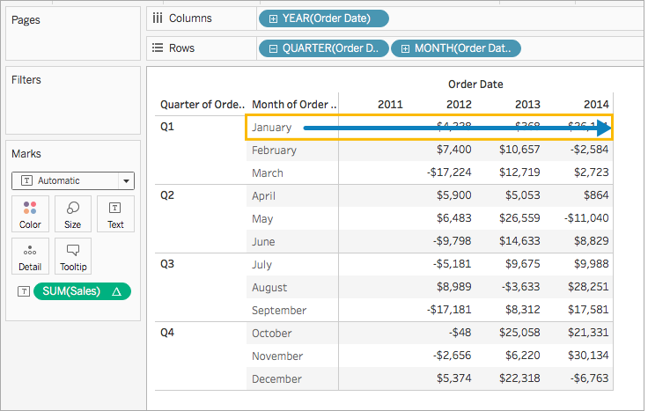
Module 5: addressing optionS
TABLE (ACROSS)
Computes across the length of the table and restarts after every partition.

Slide 28
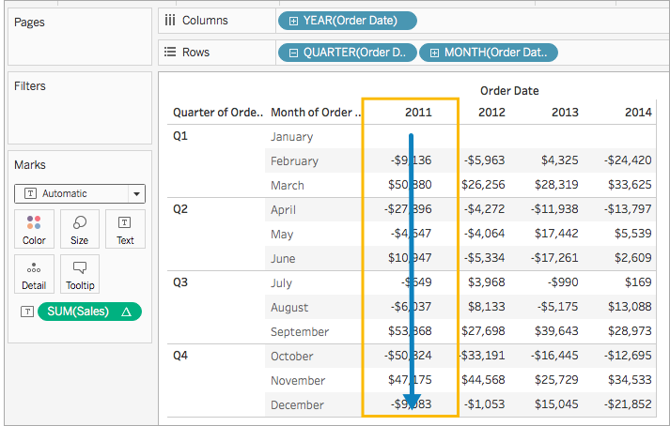
Module 5: addressing optionS
TABLE (DOWN)
Computes down the length of the table and restarts after every partition.

Slide 29
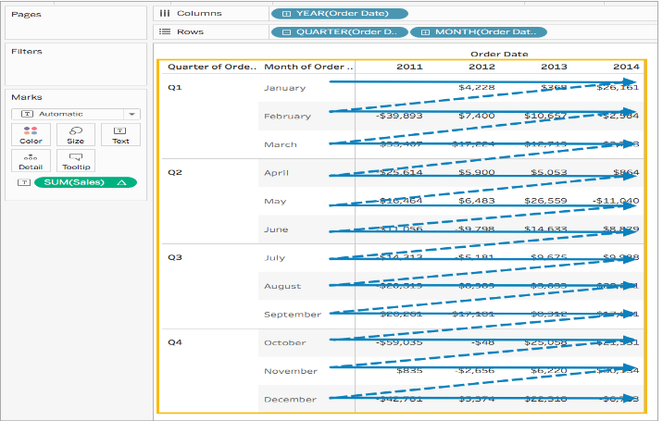
Module 5: addressing optionS
TABLE (ACROSS THEN DOWN)
Computes across the length of the table, and then down the length of the table.

Slide 30
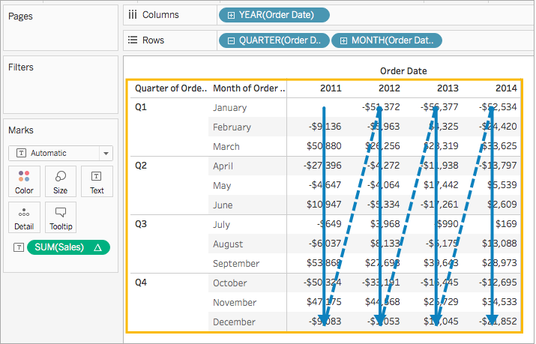
Module 5: addressing optionS
TABLE (DOWN THEN ACROSS)
Computes down the length of the table, and then across the length of the table.

Slide 31
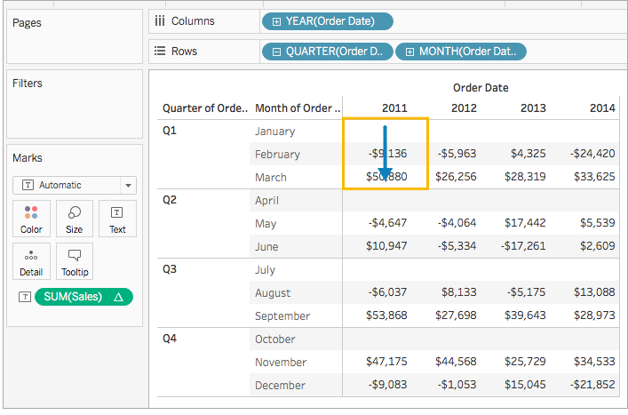
Module 5: addressing optionS
PANE (DOWN)
Computes down an entire pane.

Slide 32
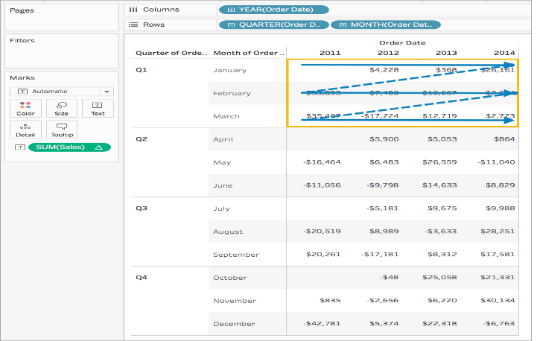
Module 5: addressing optionS
PANE (ACROSS THEN DOWN)
Computes across an entire pane and then down the pane.

Slide 33
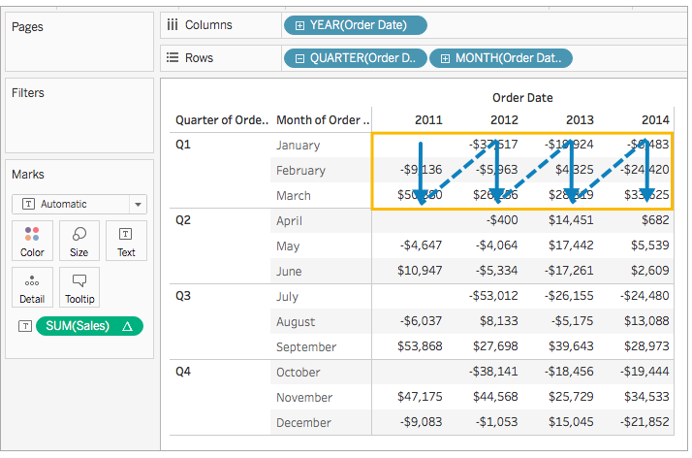
Module 5: addressing optionS
PANE (DOWN THEN ACROSS)
Computes down an entire pane and then across the pane.

Slide 34
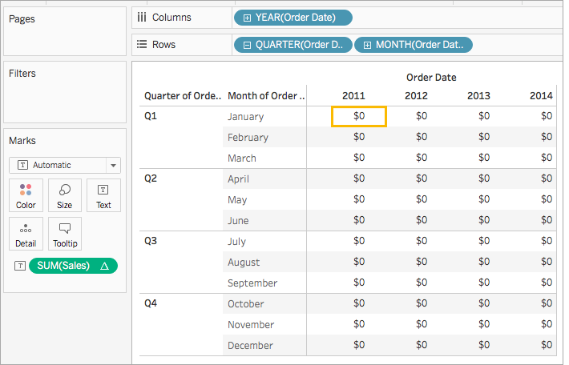
Module 5: addressing optionS
CELL
Computes within a single cell.

Slide 35
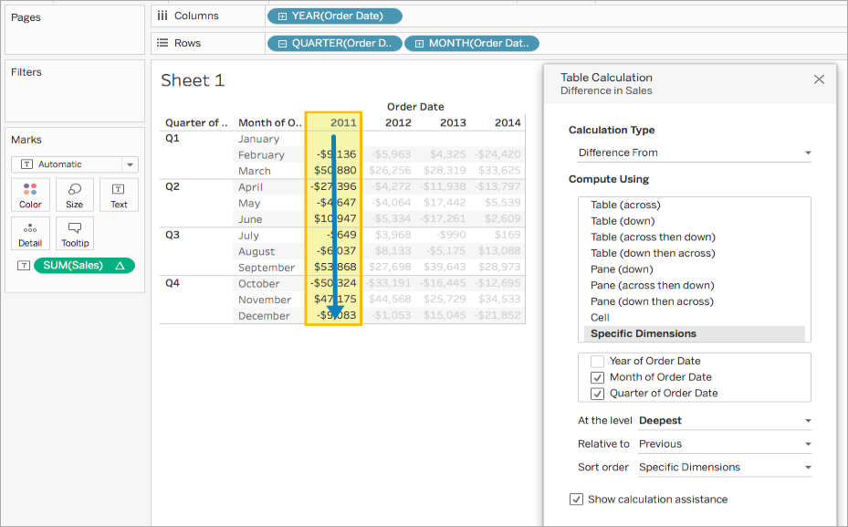
Module 5: addressing optionS
SPECIFIC DIMENSIONS
Computes only within the dimensions you specify. If all the dimensions are selected, then the entire table is in scope.

Slide 36

Module 5: addressing optionS
AT THE LEVEL
Only available when Specific Dimensions is selected.
Deepest | Calculation should be performed at the deepest level of granularity.
Quarter of Order Date | Calculation should be performed at the quarter level.
Month of Order Date | Calculation should be performed at the month level.

Slide 37
Module 6: formatting a visualization to look great and work well
Lesson 1
Formatting considerations
Lesson 2
How formatting works in Tableau
Lesson 3
Adding value to visualizations

Slide 38
Module 6: formatting considerations
Formatting Considerations
As you change the look and feel of your work, use a biggest to smallest workflow. Start by formatting fonts and titles at the workbook level, then move on to the worksheet level. Save formatting the individual parts of a view for last. A workbook is the largest possible container for formatting changes, and making changes at the workbook level first will save you time.
In terms of formatting visualizations, it is recommended that you use consistent coloring across them so your users have a visually appealing experience.

Slide 39
Module 6: how formatting works in tableau
Formatting
You can format individual parts of the view. For example, you can format a single field, resize cells and tables, and edit individual axes.
All of this is done from the format pane.

Slide 40
Module 7: telling a data story with dashboards
Lesson 1
Dashboard objectives
Lesson 2
Create viz’s for dashboard/story use
Lesson 3
Create dashboard
Lesson 4
Add interactivity to a dashboard
Lesson 5
Story points

Slide 41
Module 7: definitions
TERM | DEFINITION
Dashboard | A collection of several views, letting you compare a variety of data simultaneously. It’s an “at-a-glance” feature.
Actions | Add context and interactivity to your data using actions. Users interact with your visualizations by selecting marks, or hovering, or clicking a menu, and the actions you set up can respond with navigation and changes in the view.
Story | A sequence of visualizations that work together to convey information. Can be a series of dashboards/worksheets. Used to create a data narrative, provide context, demonstrate how decisions relate to outcomes, or simply make a compelling case.
Story Points | Each individual sheet in a story is a story point.

Slide 42
Module 7: dashboard actions
ACTIONS
Filter Highlight Go to URL Go to Sheet Change Set Values

Slide 43
Module 8: adding value to analysis – trends, distributions, and forecasting
Lesson 1
Trends
Lesson 2
Distribution
Lesson 3
Forecasting

Slide 44
Module 8: definitions
TERM | DEFINITION
Trend | When you add trend lines to a view, you can specify how you want them to look and behave. There are five model types for trends in Tableau.
Distributions | Reference distributions add a gradient of shading to indicate the distribution of values along the axis. Distribution can be defined by percentages, percentiles, quantiles, or standard deviation.
Forecasting | Forecasting in Tableau uses a technique known as exponential smoothing. Exponential smoothing models iteratively forecast future values of a regular time series of values from weighted averages of past values of the series.

Slide 45
Module 8: types of trend lines
TYPES OF TREND LINES IN TABLEAU | DEFINITION
Linear | A linear trendline is a best-fit straight line that is used with simple linear data sets. Your data is linear if the pattern in its data points resembles a line. A linear trendline usually shows that something is increasing or decreasing at a steady rate.
Logarithmic | A logarithmic trendline is a best-fit curved line that is most useful when the rate of change in the data increases or decreases quickly and then levels out. A logarithmic trendline can use negative and/or positive values.
Polynomial | A polynomial trendline is a curved line that is used when data fluctuates. It is useful, for example, for analyzing gains and losses over a large data set.
Power | A power trendline is a curved line that is best used with data sets that compare measurements that increase at a specific rate — for example, the acceleration of a race car at one-second intervals. You cannot create a power trendline if your data contains zero or negative values.
Exponential | An exponential trendline is a curved line that is most useful when data values rise or fall at increasingly higher rates. You cannot create an exponential trendline if your data contains zero or negative values.

Slide 46
Module 8: Forecast definitions
TERM | DESCRIPTION
Forecasting | Used to forecast future values over a time series.
Exponential Smoothing | Exponential smoothing models iteratively forecast future values of a regular time series of values from weighted averages of past values of the series. The exponential smoothing model gives more weight to more recent values vs. older ones.
Confidence Interval | The forecast model has determined with n% probability the estimated values of the measurement will fall within that area for that given period.
Seasonality | The predictable variation in data over a period (week, month, quarter, etc.).

Slide 47
Module 8: Forecast options – Part 1
CONFIGURING FORECAST OPTIONS | DEFINITION
Forecast Length | Determines how far into the future the forecast extends.
Automatic | Tableau determines, based on the data in the view
Exactly | Extends the forecast for the specified number of units
Until | Extends the forecast to the specified point in the future
Source Data
Aggregate by | Specifies the temporal granularity of the time series. Defaults to Automatic where Tableau chooses the best granularity for estimation. This will typically match the temporal granularity of the viz (the date dimension the forecast is based on.) It is sometimes possible and desirable to estimate at a finer granularity, if the time series in the viz is to short to allow estimation.
Ignore last | Specifies the number of periods at the end of the actual data that should be ignored in estimating the forecast model. Forecast data is used instead of actual data for these time periods. Use this feature to trim off unreliable or partial trailing periods which could mislead the forecast.
Fill in missing values with zeroes | If there are missing values in the measure you are attempting to forecast, you can specify that Tableau fill in these missing values with zero.

Slide 48
Module 8: Forecast options – Part 2
CONFIGURING FORECAST OPTIONS | DEFINITION
Forecast Model | Determines how the forecast model is to be produced.
Automatic | Tableau determines to be the best of all models
Automatic w/o Seasonality | The best of those without seasonality
Custom | Used to specify the trend and season characteristics for your model.
None | When you select None for Trend, the model does not assess the data for trend. When you select None for Season, the model does not assess the data for seasonality.
Additive | An additive model is one in which the combined effect of several independent factors is the sum of the isolated effects of each factor. You can assess the data in your view for additive trend, additive seasonality, or both.
Multiplicative | A multiplicative model is one in which the combined effect of several independent factors is the product of the isolated effects of each factor. You can assess the data in your view for multiplicative trend, multiplicative seasonality, or both.
Forecast Summary | Provides a description of the current forecast. Will update whenever any of the forecast options are changed.

Slide 49
Module 8: Forecast result options
FORECAST RESULT OPTIONS | DEFINITION
Actual & Forecast | Show the actual data extended by forecasted data.
Trend | Show the forecast value with the seasonal component moved.
Precision | Show the prediction interval distance from the forecast value for the configured confidence level.
Precision % | Show precision as a percentage of the forecast value.
Quality | Show the quality of the forecast, on a scale of 0 (worst) to 100 (best).
Upper Prediction Interval | Shows the value above which the true future value will lie confidence level percent of the time assuming a high quality model.
Lower Prediction Interval | Shows 90, 95, or 99 confidence level below the forecast value.
Indicator | Show the string Actual for rows that were already on the worksheet when forecasting was inactive and Estimate for rows that were added when forecasting was activated.
None | Do not show forecast data for this measure.

Slide 50
Module 9: making data work for you
Lesson 1
Structuring data for Tableau
Lesson 2
Dealing with data structure issues
Lesson 3
An overview of advanced fixes for data problems
Vehicles – Data Interpreter

Slide 51
Module 9: structuring data in tableau
RECOMMENDED DATA STRUCTURE
Your data should be formatted like a table or spreadsheet.
Ensure the data types are correct.
Split fields into multiple fields.
Tableau will present the data interpreter when the source is Excel, Text CSV, PDF, or Google Sheets. The data interpreter can interpret and potentially fix data.

Slide 52
Module 9: advanced fixes for data problems
FIXING DATA PROBLEMS
Renaming fields
Grouping
Aliases
Geographic errors

Slide 53
Module 10: advanced techniques, tips, and tricks
Lesson 1
Sheet swapping and dynamic dashboards
Lesson 2
Leveraging sets to answer complex questions
Lesson 3
Using background images
Lesson 4
Mapping techniques
Australian Ghost Sightings

Slide 54
Module 10: sheet swapping
SHEET SWAPPING – WHY?
Sheet swapping enables a user to view viz’s individually on dashboards. Imagine having multiple viz’s on a dashboard and a user is accessing from a mobile device, sheet swapping is extremely helpful in that situation as well as others.
Sheet swapping is a way to make your dashboards dynamic.

Slide 55
Module 10: leveraging sets
LEVERAGING SETS
You can use sets to compare and ask questions about a subset of data. Sets are custom fields that define a subset of data based on some conditions. You control the level of detail you view.
You can make sets more dynamic and interactive by using them in Set Actions. Set actions let your audience interact directly with a viz or dashboard to control aspects of their analysis. When someone selects marks in the view, set actions can change the values in a set.
In addition to a Set Action, you can also allow users to change the membership of a set by using a filter-like interface known as a Set Control, which makes it easy for you to designate inputs into calculations that drive interactive analysis.

Slide 56
Module 11: Sharing your data story
Lesson 1
Presenting, printing, and exporting
Lesson 2
Sharing a workbook with users of Tableau Desktop or Tableau Reader
Lesson 3
Sharing data with users of Tableau Server, Tableau Online, and Tableau Public

Slide 57
Module 11: sharing your data story
TERM | DESCRIPTION
Packaged Workbook | Packaged workbooks contain the workbook along with a copy of any local file data sources and background images. The workbook is no longer linked to the original data sources and images. These workbooks are saved with a .twbx file extension. Other users can open the packaged workbook using Tableau Desktop or Tableau Reader.
Tableau Reader | Email a workbook and its data source to others saved as a .twbx, and they can open and see its contents using Tableau Reader. Tableau Reader is a free application that can be used to open and see workbooks that have been built in Tableau Desktop.
Tableau Server | Tableau Server provides browser-based analytics. After publishing your workbook to Tableau Server, others with a Tableau Server account can sign in to see your workbook.
Tableau Cloud | Tableau Cloud lets you view and share dashboards from the office, at home or on the road. There are native mobile apps, that can be accessed from the Web or a mobile device. Only authorized users can interact with data and dashboards. Uses single sign-on to make security easy for trusted users.
Tableau Public | After publishing a workbook to Tableau Public, anyone with a link to the workbook can see its contents. Workbooks and the underlying data saved to Tableau Public are accessible to the public.
Export as Version | Used if you want to save to an earlier version of Tableau format.

